Slide 1


Welcome you all
JAVA PROGRAMMING
DAY : 10
D.Sakthivel
Assistant Professor & Trainer,
KGiSL Micro College
KGiSL Campus, Coimbatore – 641 035.

Slide 2
Day- 10
Java Collection
Java Collection Framework
Hierarchy of Collection Framework
Methods of Collection interface
ArrayList
LinkedList
Stack
Queue
Set
HashSet
TreeSet
Map

Slide 3
Collections in Java
Java Collection Framework
Hierarchy of Collection Framework
Collection interface
Iterator interface
The Collection in Java is a framework that provides an architecture to store and manipulate the group of objects.
Java Collections can achieve all the operations that you perform on a data such as searching, sorting, insertion, manipulation, and deletion.
Java Collection means a single unit of objects.
Java Collection framework provides many interfaces (Set, List, Queue, Deque) and classes (ArrayList, Vector, LinkedList, PriorityQueue, HashSet, LinkedHashSet, TreeSet).

Slide 4
What is Collection in Java?
A Collection represents a single unit of objects, i.e., a group.
What is a framework in Java?
It provides readymade architecture.
It represents a set of classes and interfaces.
It is optional.
What is Collection framework?
The Collection framework represents a unified architecture for storing and manipulating a group of objects. It has:
Interfaces and its implementations, i.e., classes
Algorithm

Slide 5
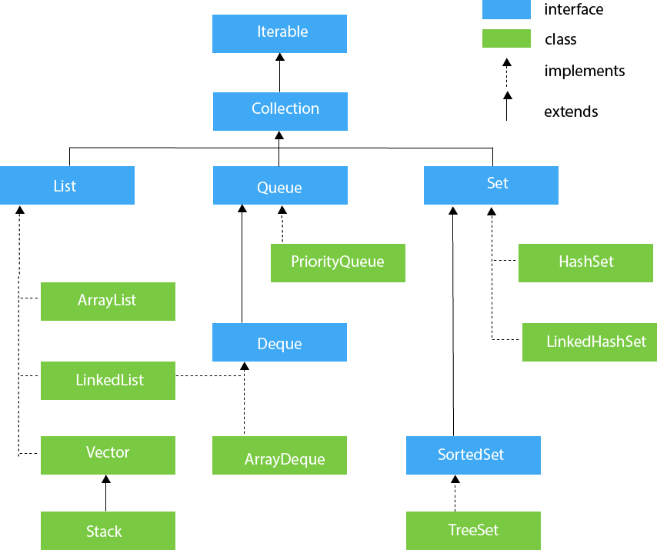
Hierarchy of Collection Framework
The java.util package contains all the classes and interfaces for the Collection framework.

Slide 6
Methods of Collection interface
No. | Method | Description
1 | public boolean add(E e) | It is used to insert an element in this collection.
2 | public boolean addAll(Collection<? extends E> c) | It is used to insert the specified collection elements in the invoking collection.
3 | public boolean remove(Object element) | It is used to delete an element from the collection.
4 | public boolean removeAll(Collection<?> c) | It is used to delete all the elements of the specified collection from the invoking collection.
5 | default boolean removeIf(Predicate<? super E> filter) | It is used to delete all the elements of the collection that satisfy the specified predicate.
6 | public boolean retainAll(Collection<?> c) | It is used to delete all the elements of invoking collection except the specified collection.

Slide 7
Methods of Collection interface
7 | public int size() | It returns the total number of elements in the collection.
8 | public void clear() | It removes the total number of elements from the collection.
9 | public boolean contains(Object element) | It is used to search an element.
10 | public boolean containsAll(Collection<?> c) | It is used to search the specified collection in the collection.
11 | public Iterator iterator() | It returns an iterator.
12 | public Object[] toArray() | It converts collection into array.

Slide 8
Methods of Collection interface
13 | public <T> T[] toArray(T[] a) | It converts collection into array. Here, the runtime type of the returned array is that of the specified array.
14 | public boolean isEmpty() | It checks if collection is empty.
15 | default Stream<E> parallelStream() | It returns a possibly parallel Stream with the collection as its source.
16 | default Stream<E> stream() | It returns a sequential Stream with the collection as its source.
17 | default Spliterator<E> spliterator() | It generates a Spliterator over the specified elements in the collection.
18 | public boolean equals(Object element) | It matches two collections.
19 | public int hashCode() | It returns the hash code number of the collection.

Slide 9
Iterator interface
Iterator interface provides the facility of iterating the elements in a forward direction only.
Methods of Iterator interface
S.No. | Method | Description
1 | public boolean hasNext() | It returns true if the iterator has more elements otherwise it returns false.
2 | public Object next() | It returns the element and moves the cursor pointer to the next element.
3 | public void remove() | It removes the last elements returned by the iterator. It is less used.

Slide 10
Iterable Interface
The Iterable interface is the root interface for all the collection classes.
The Collection interface extends the Iterable interface and therefore all the subclasses of Collection interface also implement the Iterable interface.
It contains only one abstract method. i.e.,
Iterator<T> iterator()
Collection Interface
The Collection interface is the interface which is implemented by all the classes in the collection framework.
It declares the methods that every collection will have.
In other words, we can say that the Collection interface builds the foundation on which the collection framework depends.

Slide 11
List Interface
List interface is the child interface of Collection interface.
It inhibits a list type data structure in which we can store the ordered collection of objects. It can have duplicate values.
List interface is implemented by the classes ArrayList, LinkedList, Vector, and Stack.
To instantiate the List interface, we must use :
List <data-type> list1= new ArrayList();
List <data-type> list2 = new LinkedList();
List <data-type> list3 = new Vector();
List <data-type> list4 = new Stack();
There are various methods in List interface that can be used to insert, delete, and access the elements from the list.

Slide 12
The classes that implement the List interface are given below.
ArrayList
The ArrayList class implements the List interface.
It uses a dynamic array to store the duplicate element of different data types.
The ArrayList class maintains the insertion order and is non-synchronized.
The elements stored in the ArrayList class can be randomly accessed.

Slide 13
The classes that implement the List interface are given below.
Consider the following example.
import java.util.*;
class TestJavaCollection1{
public static void main(String args[]){
ArrayList<String> list=new ArrayList<String>();//Creating arraylist
list.add("Ravi");//Adding object in arraylist
list.add("Vijay");
list.add("Ravi");
list.add("Ajay");
//Traversing list through Iterator
Iterator itr=list.iterator();
while(itr.hasNext()){
System.out.println(itr.next());
}
}
}

Slide 14
The classes that implement the List interface are given below.
LinkedList
LinkedList implements the Collection interface.
It uses a doubly linked list internally to store the elements.
It can store the duplicate elements.
It maintains the insertion order and is not synchronized.
In LinkedList, the manipulation is fast because no shifting is required.

Slide 15
The classes that implement the List interface are given below.
LinkedList
import java.util.*;
public class TestJavaCollection2{
public static void main(String args[]){
LinkedList<String> al=new LinkedList<String>();
al.add("Ravi");
al.add("Vijay");
al.add("Ravi");
al.add("Ajay");
Iterator<String> itr=al.iterator();
while(itr.hasNext()){
System.out.println(itr.next());
}
}
}

Slide 16
Vector
Vector uses a dynamic array to store the data elements.
It is similar to ArrayList.
However, It is synchronized and contains many methods that are not the part of Collection framework.

Slide 17
import java.util.*;
public class TestJavaCollection3{
public static void main(String args[]){
Vector<String> v=new Vector<String>();
v.add("Ayush");
v.add("Amit");
v.add("Ashish");
v.add("Garima");
Iterator<String> itr=v.iterator();
while(itr.hasNext()){
System.out.println(itr.next());
}
}
}

Slide 18
Stack
The stack is the subclass of Vector.
It implements the last-in-first-out data structure, i.e., Stack.
The stack contains all of the methods of Vector class and also provides its methods like boolean push(), boolean peek(), boolean push(object o), which defines its properties.
What is Data structure?
It is technique for efficient way of organizing, storing and retrieving elements in a computer. Using Stack,Queue,Array,List,Set,LinkedList,Map

Slide 19
Stack
import java.util.*;
public class TestJavaCollection4{
public static void main(String args[]){
Stack<String> stack = new Stack<String>();
stack.push("Ayush");
stack.push("Garvit");
stack.push("Amit");
stack.push("Ashish");
stack.push("Garima");
stack.pop();
Iterator<String> itr=stack.iterator();
while(itr.hasNext()){
System.out.println(itr.next());
}
}
}

Slide 20
Queue Interface
Queue interface maintains the first-in-first-out order.
It can be defined as an ordered list that is used to hold the elements which are about to be processed.
There are various classes like PriorityQueue, Deque, and ArrayDeque which implements the Queue interface.
Queue interface can be instantiated as:
Queue<String> q1 = new PriorityQueue();
Queue<String> q2 = new ArrayDeque();

Slide 21
PriorityQueue
The PriorityQueue class implements the Queue interface.
It holds the elements or objects which are to be processed by their priorities.
PriorityQueue doesn't allow null values to be stored in the queue.

Slide 22
PriorityQueue
import java.util.*;
public class TestJavaCollection5{
public static void main(String args[]){
PriorityQueue<String> queue=new PriorityQueue<String>();
queue.add("Amit Sharma");
queue.add("Vijay Raj");
queue.add("JaiShankar");
queue.add("Raj");
System.out.println("head:"+queue.element());
System.out.println("head:"+queue.peek());
System.out.println("iterating the queue elements:");
Iterator itr=queue.iterator();
while(itr.hasNext()){
System.out.println(itr.next());
}
queue.remove();
queue.poll();
System.out.println("after removing two elements:");
Iterator<String> itr2=queue.iterator();
while(itr2.hasNext()){
System.out.println(itr2.next());
}
} }

Slide 23
Deque Interface
Deque interface extends the Queue interface. In Deque, we can remove and add the elements from both the side.
Deque stands for a double-ended queue which enables us to perform the operations at both the ends.
Deque can be instantiated as:
Deque d = new ArrayDeque();

Slide 24
ArrayDeque
ArrayDeque class implements the Deque interface.
It facilitates us to use the Deque.
Unlike queue, we can add or delete the elements from both the ends.
ArrayDeque is faster than ArrayList and Stack and has no capacity restrictions.

Slide 25
import java.util.*;
public class TestJavaCollection6{
public static void main(String[] args) {
//Creating Deque and adding elements
Deque<String> deque = new ArrayDeque<String>();
deque.add("Gautam");
deque.add("Karan");
deque.add("Ajay");
//Traversing elements
for (String str : deque) {
System.out.println(str);
}
}
}

Slide 26
Set Interface
Set Interface in Java is present in java.util package. It extends the Collection interface.
It represents the unordered set of elements which doesn't allow us to store the duplicate items.
We can store at most one null value in Set.
Set is implemented by HashSet, LinkedHashSet, and TreeSet.
Set can be instantiated as:
Set<data-type> s1 = new HashSet<data-type>();
Set<data-type> s2 = new LinkedHashSet<data-type>();
Set<data-type> s3 = new TreeSet<data-type>();

Slide 27
HashSet
HashSet class implements Set Interface.
It represents the collection that uses a hash table for storage.
Hashing is used to store the elements in the HashSet.
It contains unique items.

Slide 28
import java.util.*;
public class TestJavaCollection7{
public static void main(String args[]){
//Creating HashSet and adding elements
HashSet<String> set=new HashSet<String>();
set.add("Ravi");
set.add("Vijay");
set.add("Ravi");
set.add("Ajay");
//Traversing elements
Iterator<String> itr=set.iterator();
while(itr.hasNext()){
System.out.println(itr.next());
}
}
}

Slide 29
LinkedHashSet
LinkedHashSet class represents the LinkedList implementation of Set Interface.
It extends the HashSet class and implements Set interface.
Like HashSet, It also contains unique elements.
It maintains the insertion order and permits null elements.

Slide 30
LinkedHashSet
import java.util.*;
public class TestJavaCollection8{
public static void main(String args[]){
LinkedHashSet<String> set=new LinkedHashSet<String>();
set.add("Ravi");
set.add("Vijay");
set.add("Ravi");
set.add("Ajay");
Iterator<String> itr=set.iterator();
while(itr.hasNext()){
System.out.println(itr.next());
}
}
}

Slide 31
SortedSet Interface
SortedSet is the alternate of Set interface that provides a total ordering on its elements.
The elements of the SortedSet are arranged in the increasing (ascending) order.
The SortedSet provides the additional methods that inhibit the natural ordering of the elements.
The SortedSet can be instantiated as:
SortedSet<data-type> set = new TreeSet();

Slide 32
TreeSet
Java TreeSet class implements the Set interface that uses a tree for storage.
Like HashSet, TreeSet also contains unique elements.
However, the access and retrieval time of TreeSet is quite fast.
The elements in TreeSet stored in ascending order.

Slide 33
import java.util.*;
public class TestJavaCollection9{
public static void main(String args[]){
//Creating and adding elements
TreeSet<String> set=new TreeSet<String>();
set.add("Ravi");
set.add("Vijay");
set.add("Ravi");
set.add("Ajay");
//traversing elements
Iterator<String> itr=set.iterator();
while(itr.hasNext()){
System.out.println(itr.next());
}
}
}

Slide 34
import java.util.*;
public class TestJavaCollection9{
public static void main(String args[]){
//Creating and adding elements
TreeSet<String> set=new TreeSet<String>();
set.add("Ravi");
set.add("Vijay");
set.add("Ravi");
set.add("Ajay");
//traversing elements
Iterator<String> itr=set.iterator();
while(itr.hasNext()){
System.out.println(itr.next());
}
}
}

Slide 35
Java Map Interface
A map contains values on the basis of key, i.e. key and value pair. Each key and value pair is known as an entry. A Map contains unique keys.
A Map is useful if you have to search, update or delete elements on the basis of a key.

Slide 36
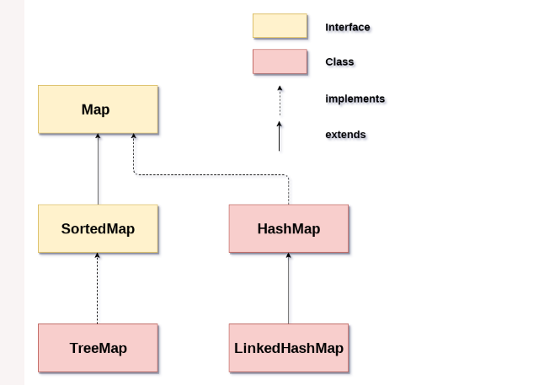
Java Map Hierarchy
There are two interfaces for implementing Map in java: Map and SortedMap, and three classes: HashMap, LinkedHashMap, and TreeMap.
The hierarchy of Java Map is given below:

Slide 37
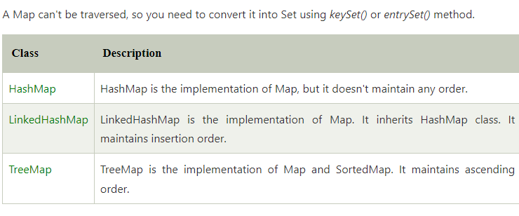
Java Map Hierarchy
A Map doesn't allow duplicate keys, but you can have duplicate values. HashMap and LinkedHashMap allow null keys and values, but TreeMap doesn't allow any null key or value.

Slide 38
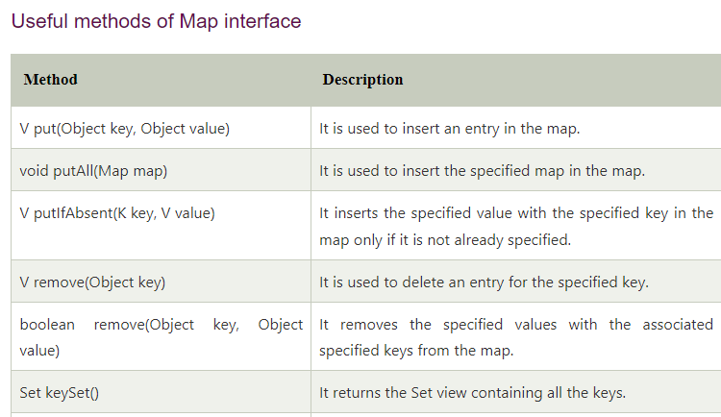

Slide 39
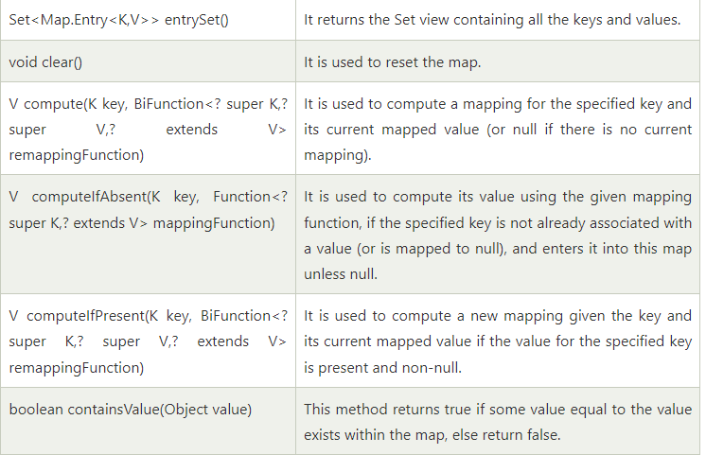

Slide 40
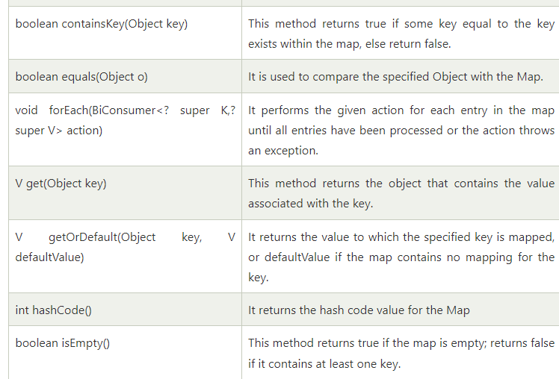

Slide 41
import java.util.*;
class MapExample2{
public static void main(String args[]){
Map<Integer,String> map=new HashMap<Integer,String>();
map.put(100,"Amit");
map.put(101,"Vijay");
map.put(102,"Rahul");
//Elements can traverse in any order
for(Map.Entry m:map.entrySet()){
System.out.println(m.getKey()+" "+m.getValue());
}
}
}

Slide 42
Java Map Example: comparingByKey()
import java.util.*;
class MapExample3{
public static void main(String args[]){
Map<Integer,String> map=new HashMap<Integer,String>();
map.put(100,"Amit");
map.put(101,"Vijay");
map.put(102,"Rahul");
//Returns a Set view of the mappings contained in this map
map.entrySet()
//Returns a sequential Stream with this collection as its source
.stream()
//Sorted according to the provided Comparator
.sorted(Map.Entry.comparingByKey())
//Performs an action for each element of this stream
.forEach(System.out::println);
}
}

Slide 43
Java Map Example: comparingByKey() in Descending Order
import java.util.*;
class MapExample4{
public static void main(String args[]){
Map<Integer,String> map=new HashMap<Integer,String>();
map.put(100,"Amit");
map.put(101,"Vijay");
map.put(102,"Rahul");
//Returns a Set view of the mappings contained in this map
map.entrySet()
//Returns a sequential Stream with this collection as its source
.stream()
//Sorted according to the provided Comparator
.sorted(Map.Entry.comparingByKey(Comparator.reverseOrder()))
//Performs an action for each element of this stream
.forEach(System.out::println);
}
}

Slide 44
Java Map Example: comparingByValue()
import java.util.*;
class MapExample5{
public static void main(String args[]){
Map<Integer,String> map=new HashMap<Integer,String>();
map.put(100,"Amit");
map.put(101,"Vijay");
map.put(102,"Rahul");
//Returns a Set view of the mappings contained in this map
map.entrySet()
//Returns a sequential Stream with this collection as its source
.stream()
//Sorted according to the provided Comparator
.sorted(Map.Entry.comparingByValue())
//Performs an action for each element of this stream
.forEach(System.out::println);
}
}

Slide 45



Thank You

